Slide 1
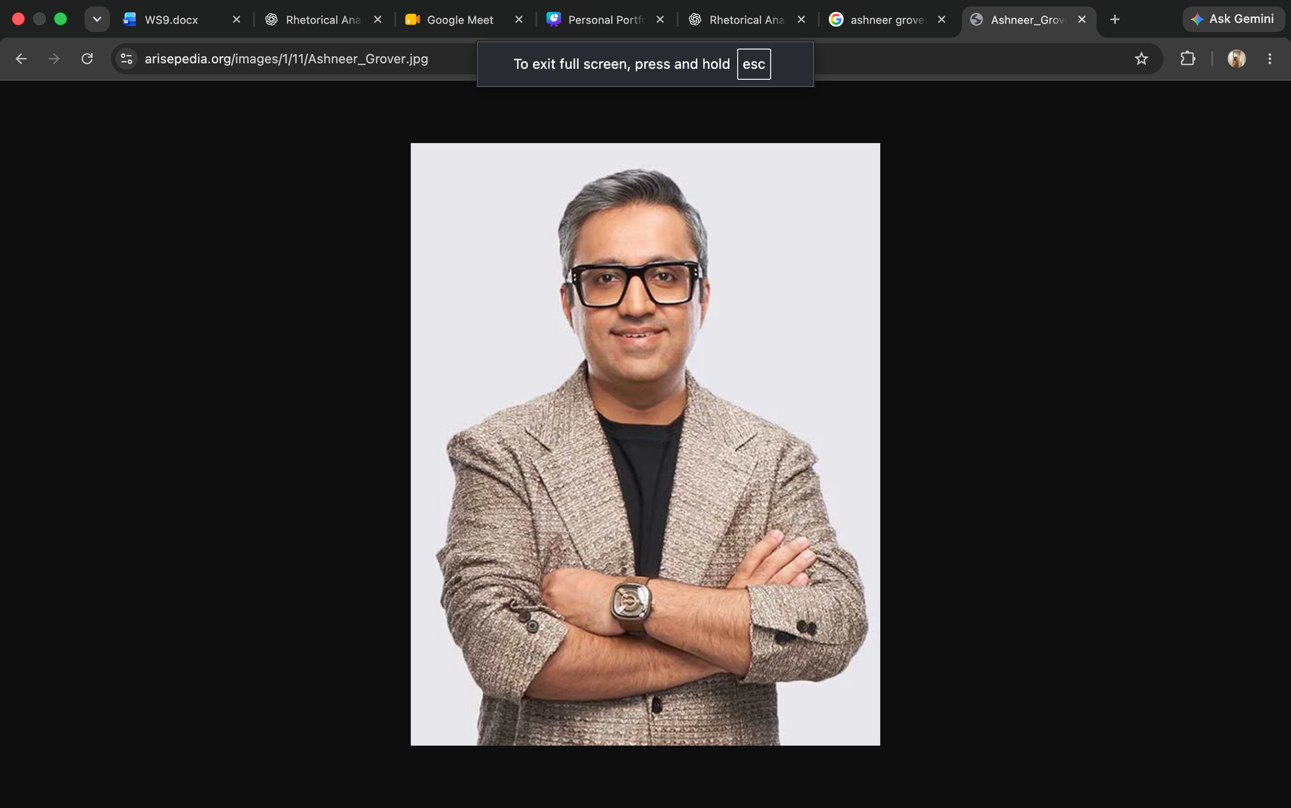
WS9 presents
THE GROVER REBOOT
From blunt criticism to actionable business wisdom — keeping the honesty, changing the impact.
Ashneer Grover: The Original Persona
Decoding His Rhetoric: Ethos, Pathos & Logos
The Rebrand: From Critic to Mentor
The New Brand Identity & Its Impact

Slide 2


Slide 3
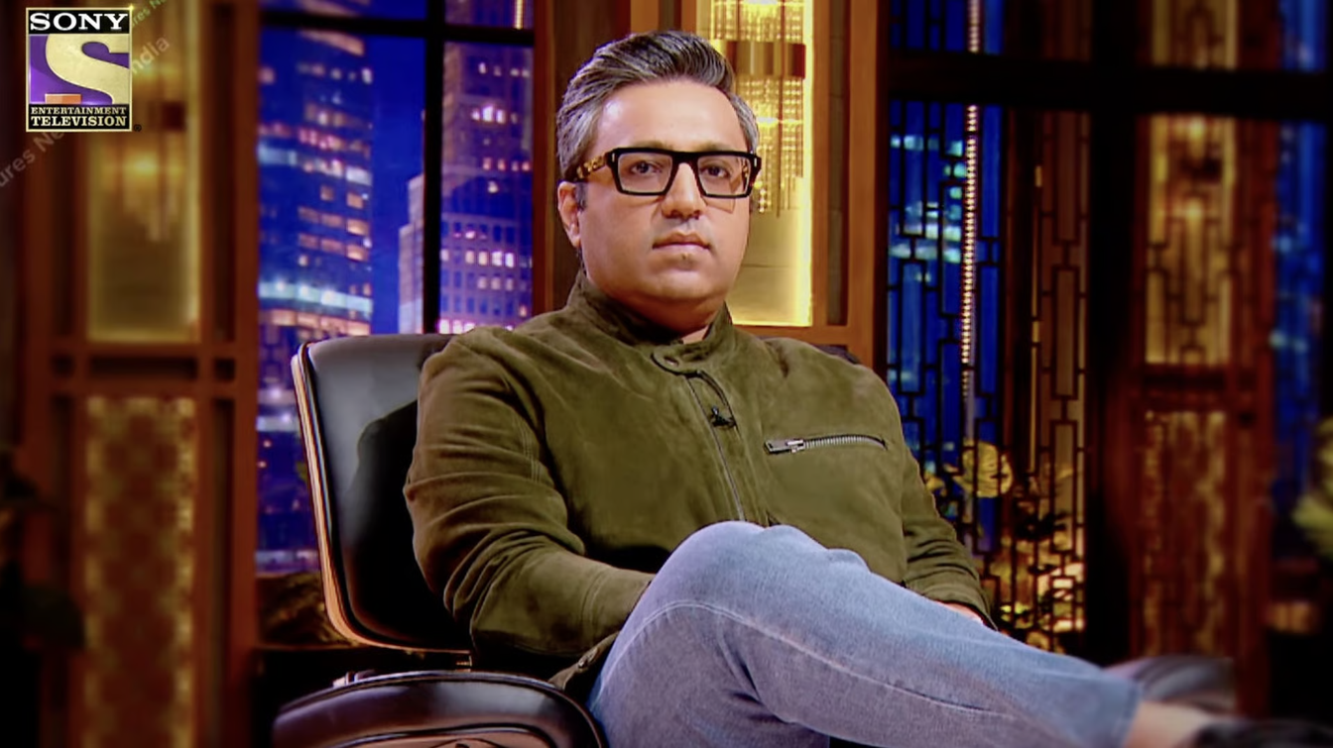
MEET:
ASHNEER GROVER
AND HIS EXISTING PUBLIC IMAGE
Entrepreneur
Investor
Built Grofers (CFO) & BharatPe
Angel Investor, Third Unicorn
BharatPe
Co-Founder
ASHNEER GROVER
Shark Tank India
Judge, Season 1
Fintech unicorn, 2018
Known For: Blunt, Confident but critical opinions and “Doglapan”

Slide 4
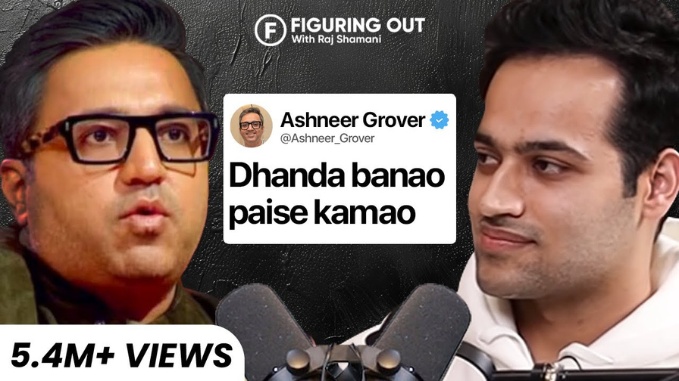
KEY HIGHLIGHTS FROM THE PODCASTS
BACK HABIT-FORMING BRANDS: SEPARATE PERSONAL LIFESTYLE FROM
INVESTING-STICKY CUSTOMER HABITS LIKE BIRA BUILD THE STRONGEST BUSINESSES
SKIP THE MBA JARGON—TICKET SIZE IS KING: SHIPPING PHYSICAL BOXES COSTS REAL MONEY, SO D2C BRANDS ONLY MAKE REAL PROFITS ONCE CUSTOMERS START PICKING THEM OFF OFFLINE STORE SHELVES.
EXPLAIN YOUR PRODUCT IN FOUR WORDS OR LESS: IN FINTECH, TRUST COMES FROM DEAD-SIMPLE PROMISES—POSTPE MEANS "PAY LATER" AND 12% CLUB MEANS "EARN OR BORROW AT 12%."
A FAST "NO" IS BETTER THAN FAKE POLITENESS: STRINGING FOUNDERS ALONG WASTES EVERYONE'S TIME, WHEREAS A REAL "YES" MEANS STANDING BY THEM WHEN CRISES HIT

Slide 5
SOAP ANALYSIS
SUBJECT
The Blunt Business Critic
Entrepreneur, investor, and former Shark Tank India judge known for his direct opinions, confidence, and no-nonsense approach to business.
OCCASION
Business Conversations & Startup Evaluation
IN HIS Interview with Raj Shamani, business decisions, entrepreneurship, profitability, and branding provide a platform to express his practical, experience-driven views..
AUDIENCE
Aspiring Entrepreneurs & Business-Minded Youth
Startup founders, business students, investors, and viewers seeking honest opinions and practical insights into real-world business challenges.
PURPOSE
Uses blunt criticism, humour, credibility, and logical reasoning to question assumptions and highlight business realities. Our rebrand aims to make this influence more constructive and solution-oriented.

Slide 6

ETHOS
•CREDIBILITY
• AUTHORITY
• EXPERIENCE
  Educational background: IIT graduate.
  Professional experience: Investment banking experience at Kotak.
  Business experience: Leadership and entrepreneurial experience at Grofers and BharatPe.
  Communication style: Confident, blunt and experience-driven
Key takeaway: His professional and entrepreneurial experience gives weight to his opinions.

Slide 7

PATHOS
•HUMOUR
• EMOTION
• RELATABILITY
  Humour and Sarcasm: Sharp one-liners and an outspoken personality.
  Conversational language: Natural Hindi-English makes his communication engaging.
  Relatability: References to education, middle-class backgrounds and everyday struggles.
  Human connection: Personal anecdotes and entrepreneurial struggles
Key takeaway: His humour, attitude and relatable communication create an emotional connection with his audience.

Slide 8

LOGOS
•LOGIC
• REASONING
• EVIDENCE
  Demonstrates Business Knowledge: Uses examples like grocery margins, operating costs, etc.
  Explains cause and effect: Connects business decisions to their financial and operational outcomes.
  Uses Facts and Reasoning: Breaks down business problems through numbers, evidence and practical examples.
Key takeaway: He backs his opinions with business knowledge, logical reasoning and evidence.

Slide 9
THE GAP IN HIS IMAGE
NOW
Criticism
WHY REDESIGN HIS PUBLIC PERSONA?
1
Bluntness can overshadow genuine advice
2
Crticism may feel discouraging
REBRAND
3
Complex issues can be made seem oversimplified
Constructive
Feedback
4
Feedback needs actionable solutions

Slide 11


ETHOS REIMAGINED
Credibility through Transparency:
  Seperate facts from opinions
  Acknowledge assumptions
  Explain the reasoning behind judgements
  Use experience to guide, not intimidate
New Principle: Trust the reasoning, not just the reputation

Slide 12
PATHOS
REIMAGINED
“Critisize the idea, not the person”
Retain humour and bluntness
Make feedback supportive
Encourage learning from mistakes
Build confidence through practical guidance
Example: “Roast tumhare idea ka hai, tumhara nahi. Fix hum saath mein banayenge”

Slide 13
LOGOS
REIMAGINED
Solve the problem, don't just spot the flaw
  Offer actionable fixes instead of harsh takedowns
  Break down unit economics stepbystep
  Replace sweeping generalizations with real market data
  Challenge the business model, not the founder
Example: “Profit isliye nhi ho para kyuki costs zyada hai,aap production capital intensive method se karo labour work expensive padhenga long term mai”

Slide 14
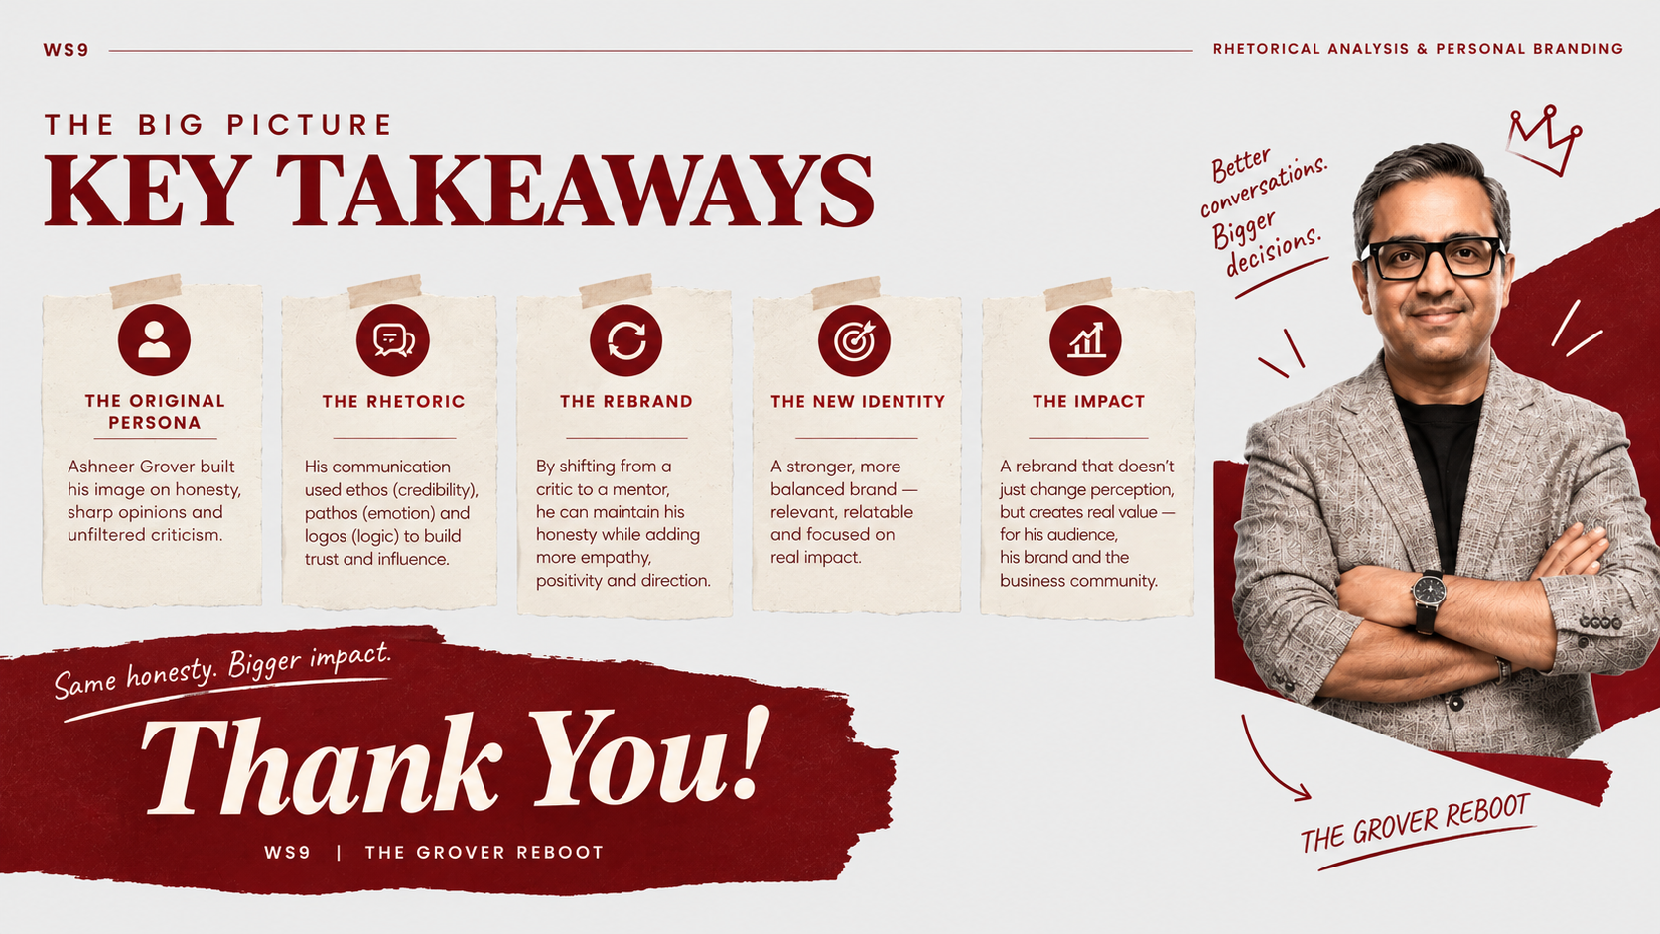
KEY TAKEAWAYS
SAME HONESTY, BETTER IMPACT

Slide 15
REFERENCES
Primary Source
Raj Shamani. (2022, February 11). Ashneer Grover Shares EASY Hacks To Make A Profitable Business | Shark Tank India | FO23 — YouTube.
https://youtu.be/nnEZVVC4Ap8
Additional Sources
Ashneer Grover Unfiltered — YouTube.
https://youtu.be/kSDvdoVt_3Y
Shark Tank India — YouTube.
https://youtu.be/xxkgj0A6aCw

Slide 16


